Slide 1
Bionimbus/PDC cookbook
V 0.02
Kevin P. Keegan PhD
Center for Data Intensive Science
September 2016

Slide 2
Introduction
Note to reader:
Lucky you!
You are one of the first to use this draft documentation.
Apologies in advance if any steps are missing or opaque.
If you run into any problems that aren’t covered, or have additional issues or questions,
please pass them on to me so I can include them in future revisions.
The easiest way for you to use Bionimbus/PDC, and for us to provide support, is to use an
operating system with a linux/unix kernel (e.g. OSX, ubuntu) if you run into problems.
Thanks
Kevin
kkeegan at uchicago.edu

Slide 3
Introduction
Section 1 outlines the process of creating an Ubuntu 14.04 virtualbox on a PC (or mac)
Section 2 outlines the basics of interacting with Bionimbus/PDC
Setting up your keys for easy access
Creating and accessing VMs
Interacting with the objectstore
If you are running OSX you can skip to section 2; however, if you run into an
issue, we strongly suggest that even OSX users try an Ubuntu virtual machine.
It will make trouble shooting much easier.

Slide 4
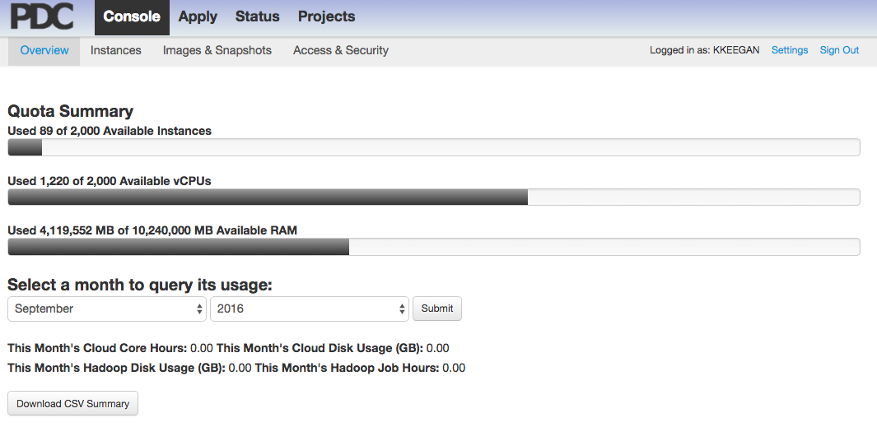
Introduction
To use Bionimbus/PDC you need to learn 6 essential skills
How to use a linux/unix based operating system to interact with the system
How to create ssh keys for use on the headnode and your VMs
How to create a configuration file to log into the headnode and/or VMs easily
How to spin up VMs
How to obtain your objectstore credentials from the headnode
How to use your objectstore credentials to access the objectstore
Section 1
Section 2
This guide outlines each of these skills in two sections

Slide 5
Section 1
The easiest way for you to use Bionimbus/PDC, and for us to provide support if you run
into problems is to use an operating system with a linux/unix kernel (e.g. OSX, ubuntu)
If you have a non linux/unix operating system (e.g. Windows) we recommend that you
use virtual box to create an Ubuntu 14.04 virtual machine on your local computer.
Even if you are using a linux/unix kernel (i.e. OSX), it may be useful to build a local Ubuntu
14.04 VM so we know that your local computer is not the source of problems and so that
our point of entry into Bionimbus/PDC is an identical platform.
Notes:
Redundant with previous slide – this shorter version may be better

Slide 6
Section 1
Setting up an Ubuntu 14.04 virtual machine on your compute with virtualbox software
is the easiest way to make sure that all users are starting from the same
exact local environment, a virtual machine running the same version of Ubuntu.
As we rarely run into issues interacting with Bionimbus/PDC from OSX, this is mostly for PC users:
I strongly encourage PC users not to use tools like Xterm, Cygwin. There are two major
issues, there are multiple versions of each of these applications, and while they work well
most of the time, in the few cases when they don’t, it can be extremely difficult and time
consuming to identify the (usually) esoteric issue(s) that cause a particular combination of
the application and your host operating system to malfunction. To date, I have run into many
such problems with PCs, but have not encountered anything more than simple problems using an Ubuntu virtual machine.
The following procedure shows you how to build an Ubuntu 14.04 image from scratch.
This will guarantee that the environment you use will be identical to the one I use.
You may opt to use images available online, or that your colleagues have prepared. This
will probably be quicker … but your environment may not be the same as that created
below. This could make debugging down the road a little trickier.

Slide 7
Section 1
Setting up an Ubuntu 14.04 virtual machine on your compute with virtualbox software.
- Download the most recent version of virtualbox for your local machine:
https://www.virtualbox.org/wiki/Downloads
- Get a copy of the virtual box instructions:
http://download.virtualbox.org/virtualbox/5.1.4/UserManual.pdf
- If you don’t already have one, download a BitTorrent client like Vuze or Mu-Torrent
Install and start the BitTorrent client before clicking on one of the links below:
Download the official Ubuntu 14.04 image:
Torrent for 32 bit version*
Torrent for 64 bit version*
Note: these are links to torrent files*
(If your local operating system is 32 bit, choose the 32 bit version. If you have a
64 bit operating system I’d recommend the 64 bit version, but you could use either)
Don’t know if you are running a 32 or 64 bit OS, this should help
- After the torrent download is complete you may want to close or uninstall the BitTorrent client
*Note: If you need help using a BitTorrent client to download an Ubuntu image, please
add a comment to this page and/or email kkeegan at uchicago.edu

Slide 8
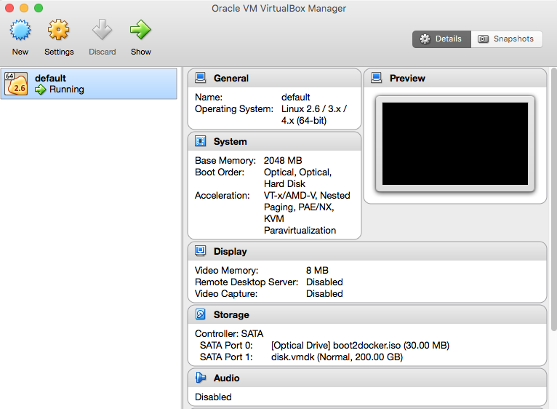
Section 1
Setting up an Ubuntu 14.04 virtual machine on your compute with virtualbox software.
Start Virtual box and click on new:

Slide 9
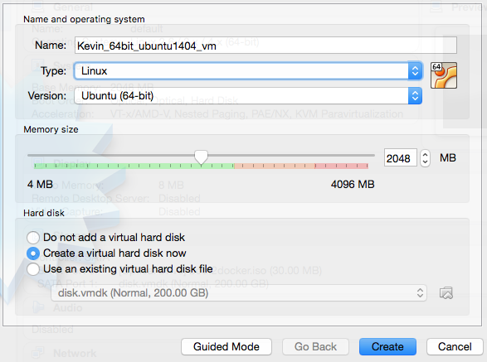
Section 1
Setting up an Ubuntu 14.04 virtual machine on your compute with virtualbox software.
Start Virtual box and click on new:
(1) Create a name for the VM
(3) Select amount of RAM for your
VM I recommend 2GB or more,
but no more than 50% of your total
RAM. Note: The VM will only use this
RAM when it is running.
Less RAM will work – I have run
Ubuntu (slowly) with 256MB
(2) Type = “Linux”
Version = 32 or 64 bit
(4) Check “Create a virtual hard disk”
(5) Click on “Create”

Slide 10
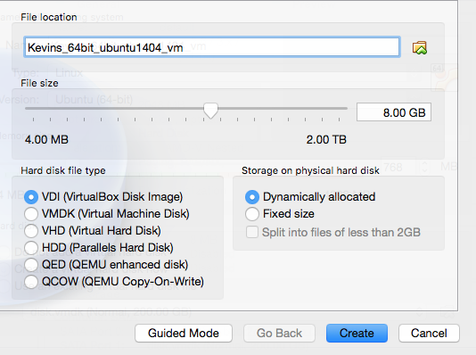
Section 1
Setting up an Ubuntu 14.04 virtual machine on your compute with virtualbox software.
(1) Select the amount of disk space for your virtual HD
8-10GB should be more than enough.
Later we’ll share a directory from your host operating system that you can
use if you need to work with files that exceed this limited space.
(2) You can also click on the
“Dynamically allocated”
option to use the space just
when you need it
(3) Click on “Create”

Slide 11
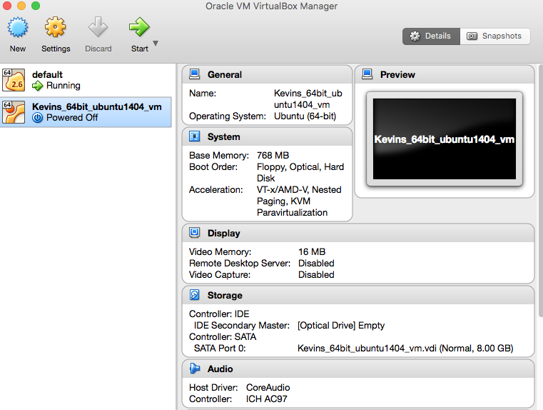
Section 1
Setting up an Ubuntu 14.04 virtual machine on your compute with virtualbox software.
(2) Then click on start
(1) Select your new VM

Slide 12
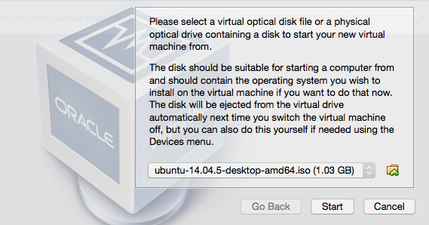
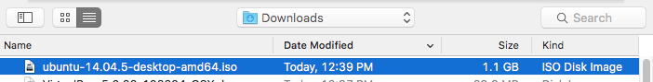
Section 1
Setting up an Ubuntu 14.04 virtual machine on your compute with virtualbox software.
When it starts the first time it will ask
For the location of the image file
Select the image file that you downloaded with BitTorrent – it should look something like the one
shown here:
It may take several minutes for your VM to boot up for the first time

Slide 13
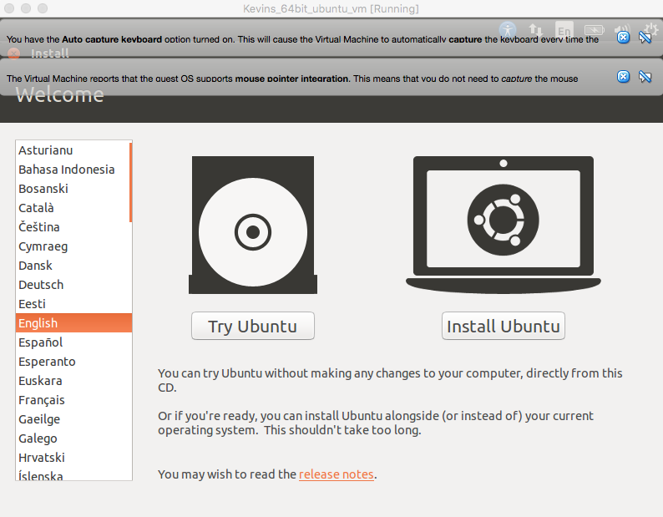
Section 1
Setting up an Ubuntu 14.04 virtual machine on your compute with virtualbox software.
Run the ubuntu installer:
(1) Click on “Install Ubuntu”

Slide 14
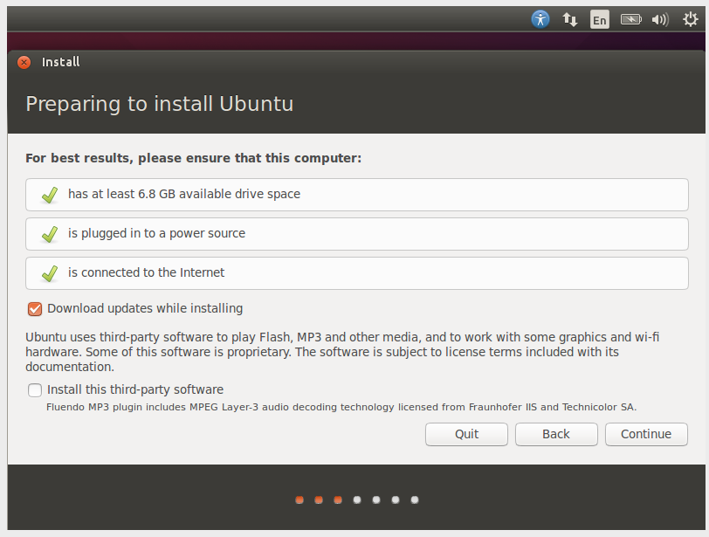

Section 1
Setting up an Ubuntu 14.04 virtual machine on your compute with virtualbox software.
Run the ubuntu installer:
(2) Check to download updates
(3) Check to download 3rd party updates
(4) Click on “Continue” (you don’t need to change any of the defaults)

Slide 15
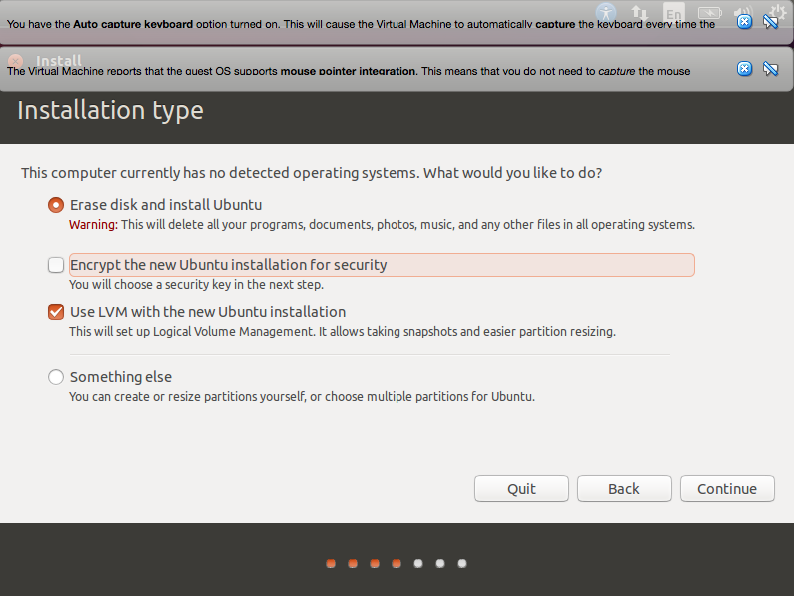
Section 1
Setting up an Ubuntu 14.04 virtual machine on your compute with virtualbox software.
Run the ubuntu installer:
(5) Check to use LVM, decide if you want the VM encrypted – note that this will
require an additional installation step to create keys. (I have not done that here)
Note: Options selected here only affect the virtual HD you assigned to the VM
(6)Click “Continue/Install Now”

Slide 16
Section 1
Setting up an Ubuntu 14.04 virtual machine on your compute with virtualbox software.
Run the ubuntu installer:
(7) The installer will ask a few additional questions
- Username
- Password (will also be your sudo password later on)
If you want the password entered automatically
Option to encrypt your home directory
Note: You may not be able to see the whole screen – just click and drag the top black
portion of the window as you would any program/window in Windows
or OSX until you can see the “OK” button (lower right)
(8) Eventually you will be asked to “Restart Now”
The new Ubuntu VM will run through a series of checks and then start.
(9) If the VM gets stuck for several minutes during this process, just close and restart it.

Slide 17
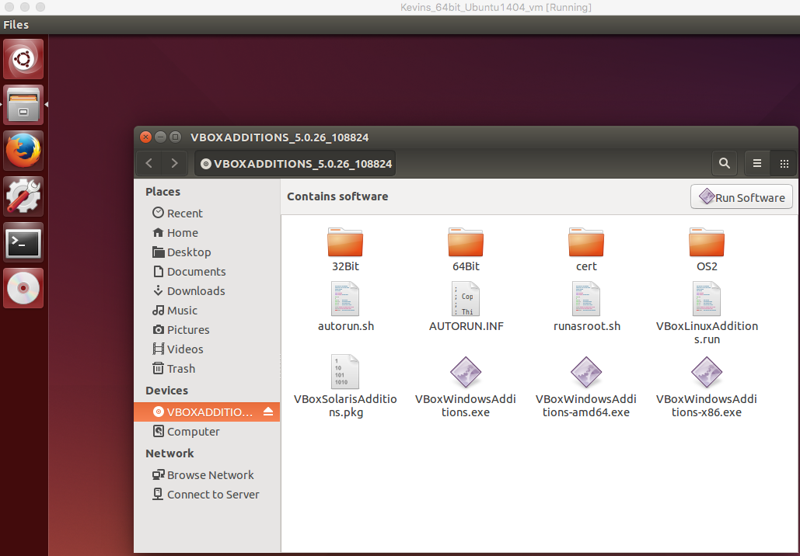
Section 1
Setting up an Ubuntu 14.04 virtual machine on your compute with virtualbox software.
Install guest additions on the new VM:
Start the virtual machine
(1) On the host machine (not the VM) click on the “Device” menu of the virtual box
console. Then click on the bottom option, it should say something along the lines of
“insert guest additions CD image”.
(4) and then click on the “run software”
You may
receive a prompt to enter your VM password
(2) You will see a CD appear on the left-hand side bar
in the Ubuntu VM.
(3) Double click on the CD

Slide 18
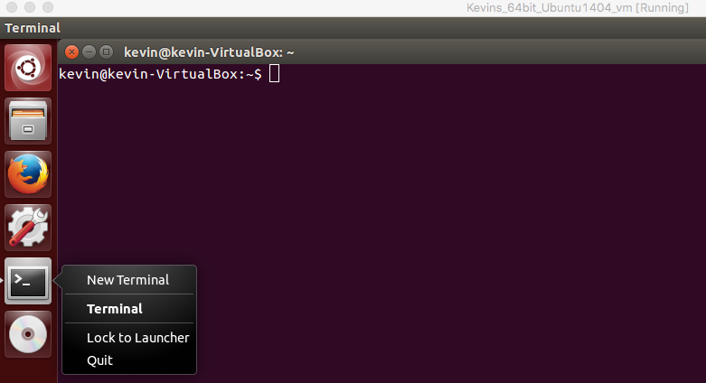
Section 1
Setting up an Ubuntu 14.04 virtual machine on your compute with virtualbox software.
Add a permanent icon to quickly access a terminal & reboot the VM
Start a terminal (ctrl + alt + t). A terminal window will appear as well as a terminal icon
on in the left hand control bar
(2) You can create a permanent terminal icon if you right click on the terminal icon and then left click on “lock
(3) Restart the VM by typing “sudo reboot” in the terminal. You will be asked for your password

Slide 19
Section 1
Setting up an Ubuntu 14.04 virtual machine on your compute with virtualbox software.
Notes:
Note Related to Guest Additions: Guest additions installs several utilities that make the VM much more convenient to use on your local machine. Overall performance should be dramatically improved. You'll be able to resize the the screen. Sharing a folder between the host machine and the virtual machine will be possible(instructions on folder sharing are next). A number of other tools and capabilities are installed.
Additional Note for OSX users: I have had some trouble getting guest additions to load properly onto OSX machines. Make sure that you are using the most up to date version of virtualbox and the most current version of the guest-additions, that usually solves any
problems – note that apple has released several os updates in the past few weeks.

Slide 20
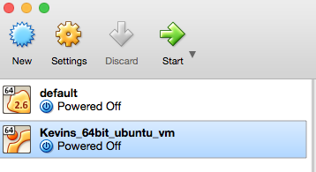
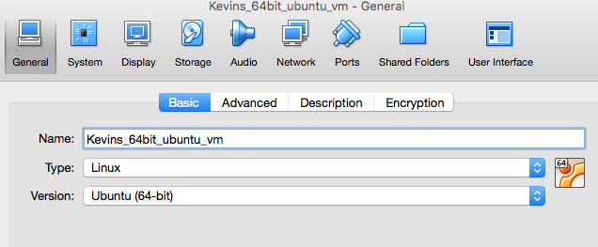
Section 1
Setting up an Ubuntu 14.04 virtual machine on your compute with virtualbox software.
Create a folder shared from host machine to VM:
Adapted from http://stackoverflow.com/questions/23514244/share-folders-from-the-host-mac-os-to-a-guest-linux-system-in-virtualbox
With the Virtual Machine powered off and selected in VirtualBox,
go to: (2) Machine > Settings > Shared Folders

Slide 21
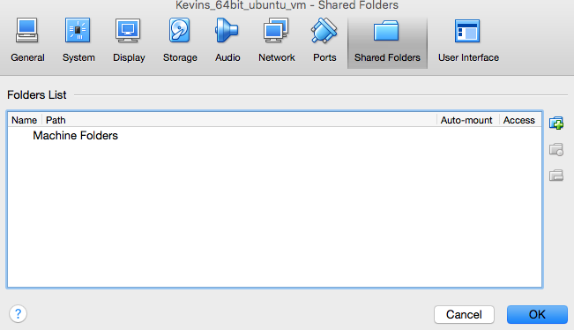
Section 1
Setting up an Ubuntu 14.04 virtual machine on your compute with virtualbox software.
Create a folder shared from host machine to VM:
(3) For “Folder Path”, click the icon to browse for the folder you want to share.
Click “OK” and start the virtual machine again.

Slide 22
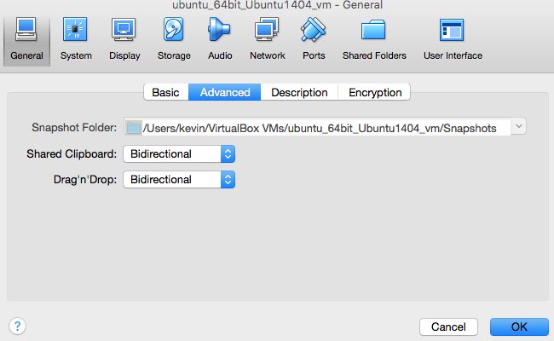
Section 1
Setting up an Ubuntu 14.04 virtual machine on your compute with virtualbox software.
(4) While you are in the settings – click on the general tab and click on advanced
Change the “Shared Clipboard” setting to “Bidirectional”
Change the “Drag’n’Drop” setting to “Bidirectional”
(5) Click on ok

Slide 23
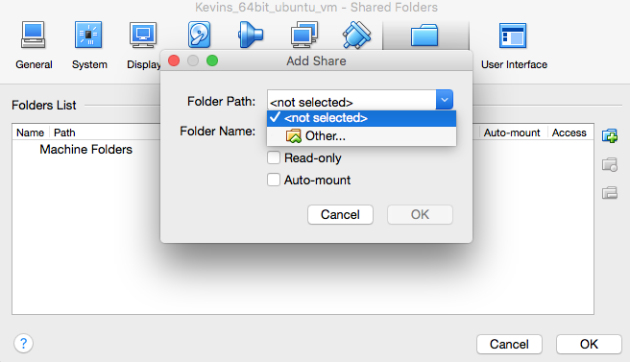
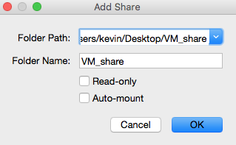
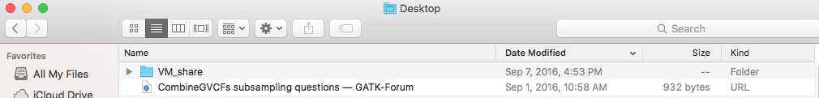
Section 1
Setting up an Ubuntu 14.04 virtual machine on your compute with virtualbox software.
Create a folder shared from host machine to VM:
(5) Then select the path to the folder you
want to share on your local machine:
(4) Select “Other”
(6) For “Folder Name”, enter a name to describe the share – or just use the default
(7) Check the “auto mount” box, and
then click “ok”

Slide 24
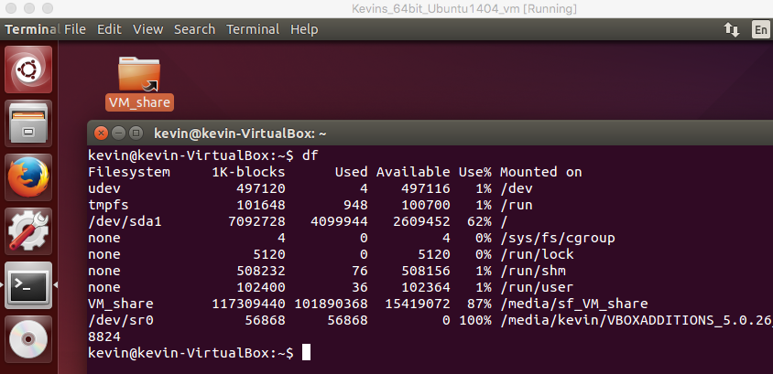
Section 1
Setting up an Ubuntu 14.04 virtual machine on your compute with virtualbox software.
Create a folder shared from host machine to VM:
(8) Start the VM
(9) Open a terminal
(10) Type “df” and press enter and you will something like the following
This is the shared folder

Slide 25
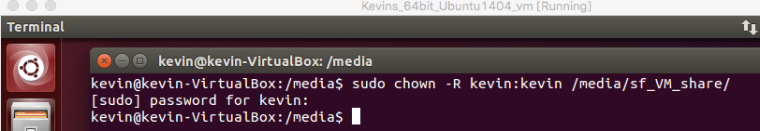
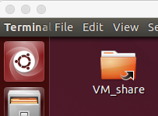
Section 1
Setting up an Ubuntu 14.04 virtual machine on your compute with virtualbox software.
Create a folder shared from host machine to VM:
(11) Give your user full access to the shared folder by typing this in the terminal
sudo chown -R yourusername:yourusername /FOLDER/
For my VM username ( kevin ) and FOLDER ( /media/sf_VM_share/ ) the command
will look like this
(12) Press enter and then restart the VM with the following command:
sudo reboot
(13) Open a terminal and enter a command like this to create a link to the shared directory
on the desktop in your virtual machine
ln -s /FOLDER/ /home/yourusername/Desktop/VM_share
This will create a link to the shared folder on the desktop
The link is to /media/sf_VM_share, but is called VM_share:
Notes:
These steps are buggy – additional things to try, shutdown and restart the VM
sudo chown -R yourusername:yourusername Pictures
sudo usermod -a -G group user
sudo adducer ubuntu root
sudo adduser USER GROUP # sudo adducer ubuntu root

Slide 26
Section 1
Setting up an Ubuntu 14.04 virtual machine on your compute with virtualbox software.
Now you have an ubuntu virtual machine that you can use to easily interact with
Bionimbus/PDC.
Using the shared folder, you can move files back and forth between the
virtual machine and the host machine it is running on.
Read the virtualbox documentation to see how you can create a snapshot of this image
to share with colleagues so you all can work from identical starting environments

Slide 27
Section 2: Local configuration and Bionimbus/PDC basics
To use Bionimbus/PDC you need to learn 6 essential skills
How to use a linux/unix based operating system to interact with the system
How to create ssh keys for use on the headnode and your VMs
How to create a configuration file to log into the headnode and/or VMs easily
How to spin up VMs
How to obtain your objectstore credentials from the headnode
How to use your objectstore credentials to access the objectstore
(1) Click on “Access & Security”

Slide 28
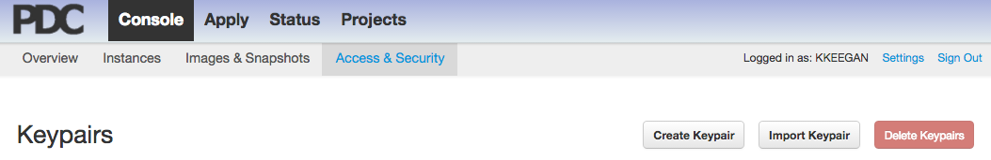
Section 2: Local configuration and Bionimbus/PDC basics
(2) To generate the key pair for the headnode
click here:
You will create two ssh key pairs.
One for access to the headnode.
The other to access VMs that you create.
For each key pair, a public (remains on Bionimbus/PDC)
and private(you will download this to your computer)
are generated

Slide 29
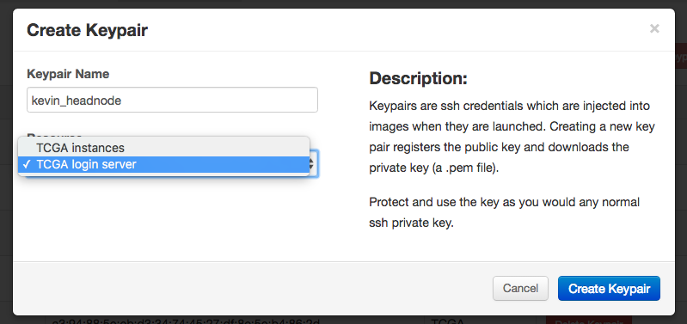
Section 2: Local configuration and Bionimbus/PDC basics
(3) Enter a name for your headnode keypair
I suggest a name that makes it obvious that
It is for the headnode
(2) On the dropdown menu,
select “login server”
Note: it IS NOT the default option
(4) Click on “create keypair”

Slide 30
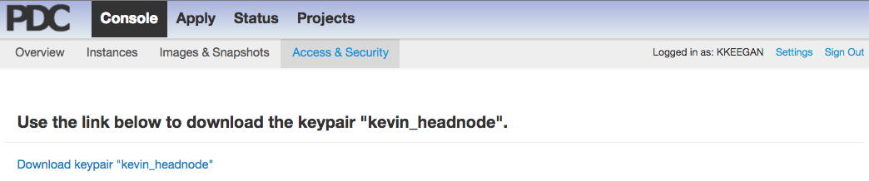
Section 2: Local configuration and Bionimbus/PDC basics
You will be taken to a page that looks like this:
(5) Click on this link to download your private headnode key.
The downloaded file will have a “pem” extension
Note: Your private key is just that, private. You and only you may use this key to access Bionimbus/PDC.
Keep your key secure – anyone can use it to access your Bionimbus/PDC
resources.
You have just created your keypair for the headnode

Slide 31
Section 2: Local configuration and Bionimbus/PDC basics
(6) After you download your headnode key, click on the “access & security tab

Slide 32
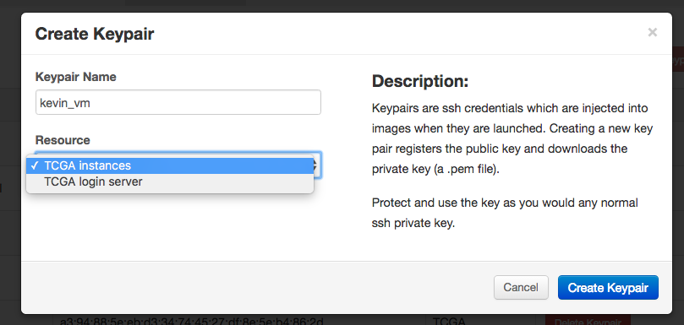
Section 2: Local configuration and Bionimbus/PDC basics
(7) Enter a name for your VM keypair
I suggest a name that makes it obvious that
It is for VMs
(8) On the dropdown menu,
select “instances”
Note: This IS the default option
(9) Click on “create keypair”

Slide 33
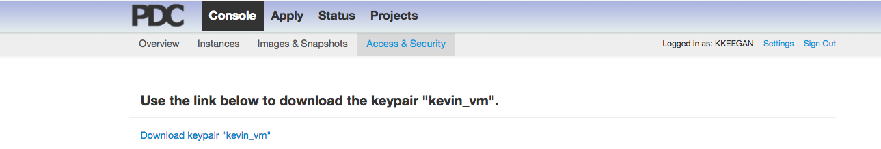
Section 2: Local configuration and Bionimbus/PDC basics
(10) Click here to download your instance private key

Slide 34
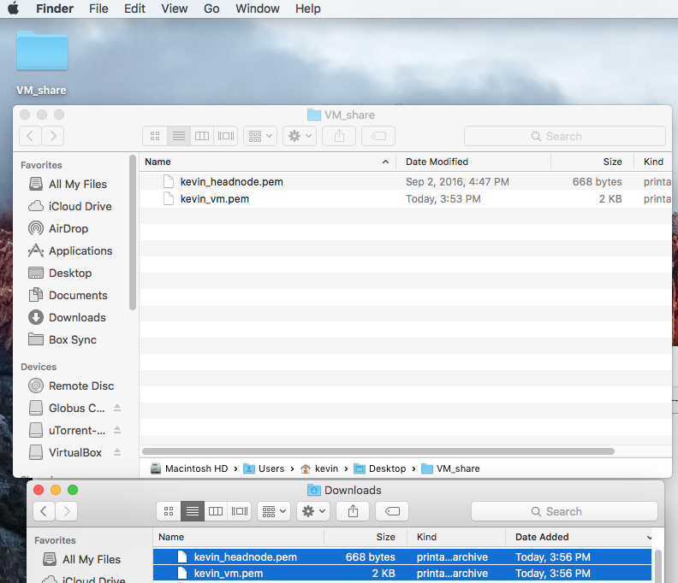
Section 2: Local configuration and Bionimbus/PDC basics
To use Bionimbus/PDC you need to learn 6 essential skills
How to use a linux/unix based operating system to interact with the system
How to create ssh keys for use on the headnode and your VMs
How to create a configuration file to log into the headnode and/or VMs easily
How to spin up VMs
How to obtain your objectstore credentials from the headnode
How to use your objectstore credentials to access the objectstore
Copy the two private key files (*.pem) that you just downloaded into the folder
shared with the virtual machine we created earlier

Slide 35
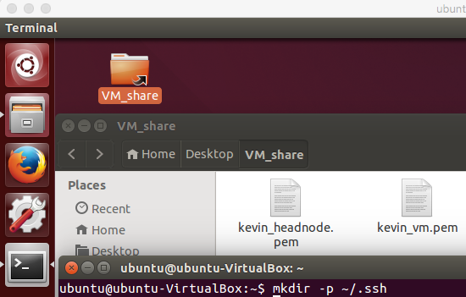
Section 2: Local configuration and Bionimbus/PDC basics
(2) Start the VM if it isn’t already running
(3) Make sure that a ~/.ssh folder exists on the VM, enter this command in a terminal. The following command will only create the directory if it does not
already exist:
mkdir -p ~/.ssh
(4) Copy the *.pem files into the ~/.ssh directory
cd ~/Desktop/VM_share/
cp *.pem ~/.ssh/

Slide 36
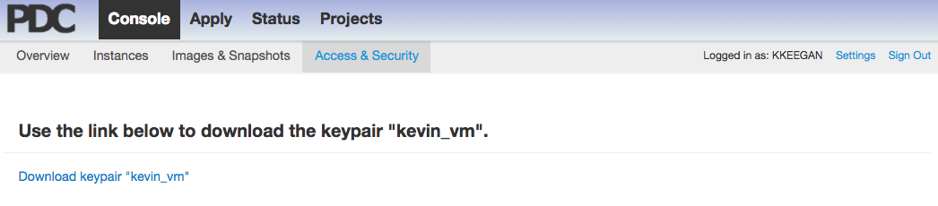
Section 2: Local configuration and PDC basics
To use Bionimbus/PDC you need to learn 6 essential skills
How to use a linux/unix based operating system to interact with the system
How to create ssh keys for use on the headnode and your VMs
How to create a configuration file to log into the headnode and/or VMs easily
How to spin up VMs
How to obtain your objectstore credentials from the headnode
How to use your objectstore credentials to access the objectstore
Click on this link to download your private VM key.
The downloaded file will have a “pem” extension
Note: Your private key is just that, private. You and only you may use this key to access Bionimbus/PDC.
Keep your key secure – anyone can use it to access your Bionimbus/PDC resources.
You have just created your keypair for your VMs

Slide 37
Section 2: Local configuration and Bionimbus/PDC basics
To use Bionimbus/PDC you need to learn 6 essential skills
How to use a linux/unix based operating system to interact with the system
How to create ssh keys for use on the headnode and your VMs
How to create a configuration file to log into the headnode and/or VMs easily
How to spin up VMs
How to obtain your objectstore credentials from the headnode
How to use your objectstore credentials to access the objectstore
There are a number of different ways to use your keys to log into the
headnode, and from the headnode to your VMs.
We recommend that you use a config file to enable “multi-hopping” –
From the user end you will be able to log into a VM with a single step,
the code will log into the headnode and use a proxy to automatically log from
the headnode into your VM
First, open up a terminal window
If you are using and ubuntu virtual machine just press ctrl + alt + t

Slide 38
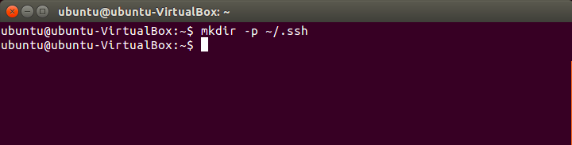
Section 2: Local configuration and Bionimbus/PDC basics
First, open up a terminal window
If you are using and ubuntu virtual machine just press ctrl + alt + t
For OSX look under application->utilities->terminal
You have to create a $HOME/.ssh directory if one doesn’t exists.
You can do it by typing this
mkdir –p ~/.ssh
Notes: “~” is a shortcut for $HOME,
-p will not overwrite an existing directory
$HOME is just a variable that holds the location of your home directory
Type “echo $HOME” if you are curious to see what it is

Slide 39
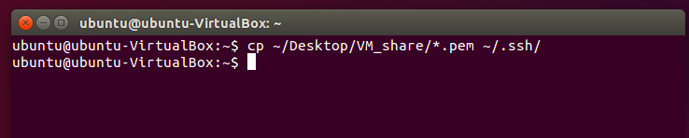
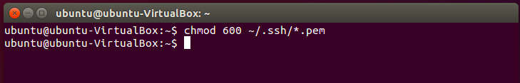
Section 2: Local configuration and Bionimbus/PDC basics
Then copy your downloaded keys to the ~/.ssh directory
(from the shared directory if you are using the Ubuntu VM)
Something like the following command should do the trick
﻿cp ~/Desktop/VM_share/*.pem ~/.ssh/
Make sure your keys have the appropriate permissions
chmod 600 ~/.ssh/*.pem

Slide 40
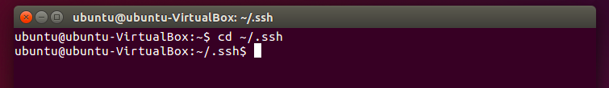
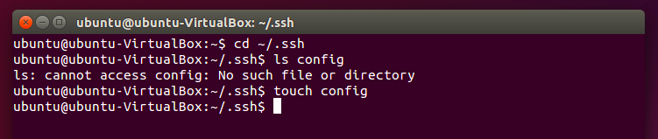
Section 2: Local configuration and Bionimbus/PDC basics
Enter the ssh directory
See if it contains a file called “config” like this
ls config
It will return the name of the file if it exists, and an error if it does not
If the file does not exist use the command “touch config” to create it

Slide 41
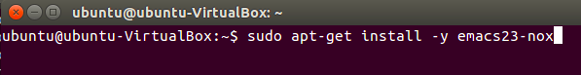
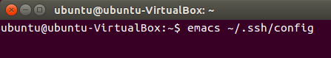
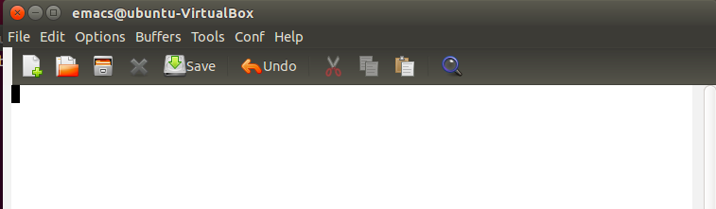
Section 2: Local configuration and Bionimbus/PDC basics
Now open the config file with the “emacs” editor (it is not pre-installed, but
is generally more user friendly than built in alternative like “vi” )
If you prefer any other editor, please use it instead
Install emacs with the following command
“﻿ sudo apt-get install -y emacs”
Open the (empty) config file with the following command
“emacs ~/.ssh/config”
You should see an empty editor like this:
If you know Ubuntu, feel free to use any other text editor.
For the sake of simplicity, the following example will continue to use “vi”

Slide 42
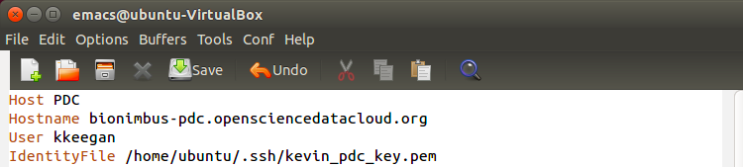
Section 2: Local configuration and Bionimbus/PDC basics
Your config file will contain a shortcut that will enable you to ssh into the
Bionimbus/PDC headnode easily.
Paste these lines into the file, editing
“YOUR_USER_NAME” to be your Bionimbus/PDC username and
your_pdc_headnode_key.pem to be the path of the headnode ssh key (*.pem file)
you copied to the ~/.ssh directory in an earlier step
Host PDC
Hostname bionimbus-pdc.opensciencedatacloud.org
User YOUR_USER_NAME
IdentityFile /home/ubuntu/.ssh/your_pdc_headnode_key.pem
It will also contain entries for each of your VMs that will allow you to multihop
into the VM without having to directly ssh into the headnode and then the VM

Slide 43
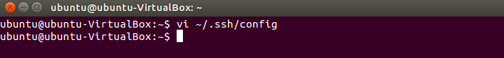
Section 2: Local configuration and Bionimbus/PDC basics
To save the file, press
ctrl + x
and then
ctrl + s
To quit press
ctrl + x
and then
ctrl + c
You will return to the original terminal prompt:

Slide 44
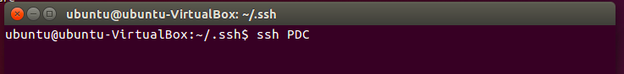
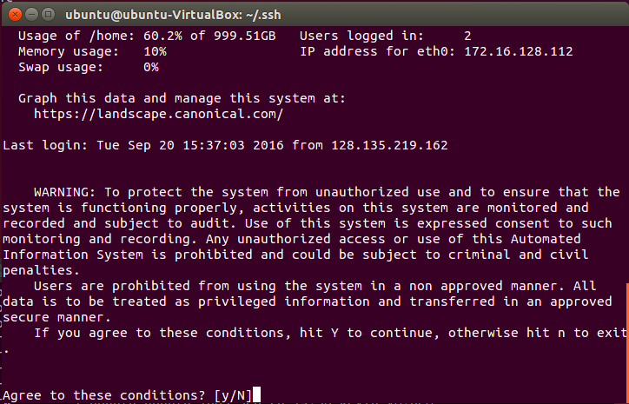
Now you can log into the Bionimbus/PDC headnode:
The long way(no don’t do it!!!)
ssh YOUR_USER_NAME@bionimbus-pdc.opensciencedatacloud.org -i ~/.ssh/your_pdc_headnode_key.pem
Or the easy way (ssh grabs the values from the config file)
ssh PDC
Note that either way, Bionimbus/PDC will prompt you to press “y” to agree to the user agreement you will be booted out of Bionimbus/PDC if you enter “n” or anything other than “y”
“y”
Welcome to the Bionimbus/PDC!

Slide 45
Section 2: Local configuration and Bionimbus/PDC basics
For now, exit Bionimbus/PDC by typing exit or closing the terminal
Notes:
The headnode is only for logging into Bionimbus/PDC and creation and control of your VMs.
You should never try to perform a compute on the headnode.
You should never try to install software on the headnode
All compute tasks should be performed on VMs

Slide 46
Section 2: Local configuration and Bionimbus/PDC basics
To use Bionimbus/PDC you need to learn 6 essential skills
How to use a linux/unix based operating system to interact with the system
How to create ssh keys for use on the headnode and your VMs
How to create a configuration file to log into the headnode and/or VMs easily
How to spin up VMs
How to obtain your objectstore credentials from the headnode
How to use your objectstore credentials to access the objectstore
Now we’ll create a VM with the UI and then add its address to the config file
for easy access

Slide 47
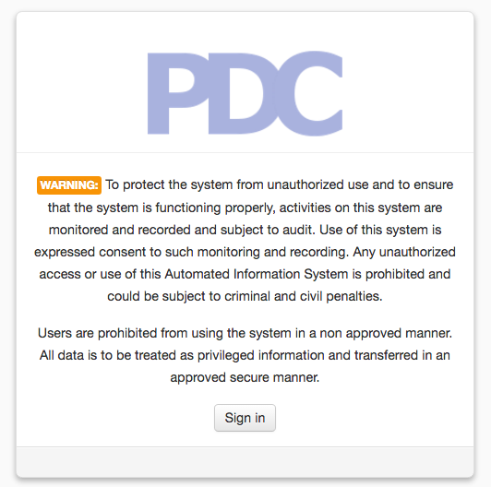
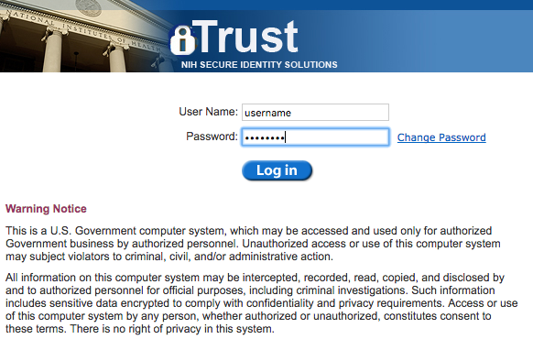
First – go to the Bionimbus/PDC console page and log in:
(2) Enter your username
your password
and click on “log in”
(1) Click here

Slide 48
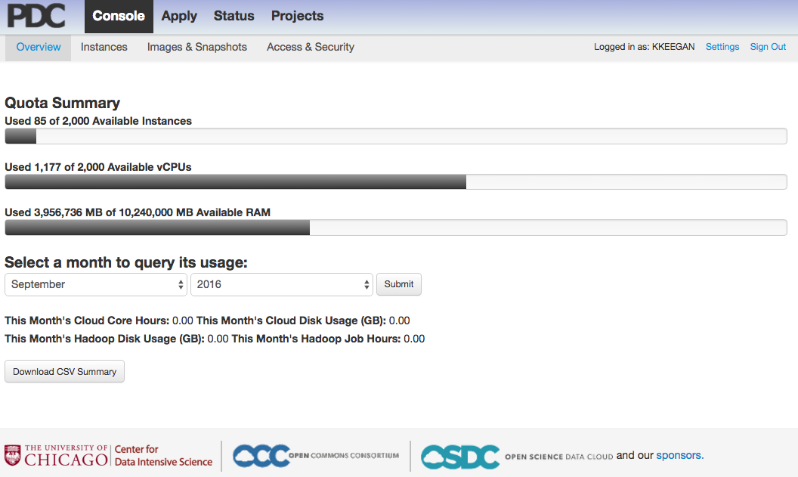
(3) Select the “Images & Snapshots” tab

Slide 49
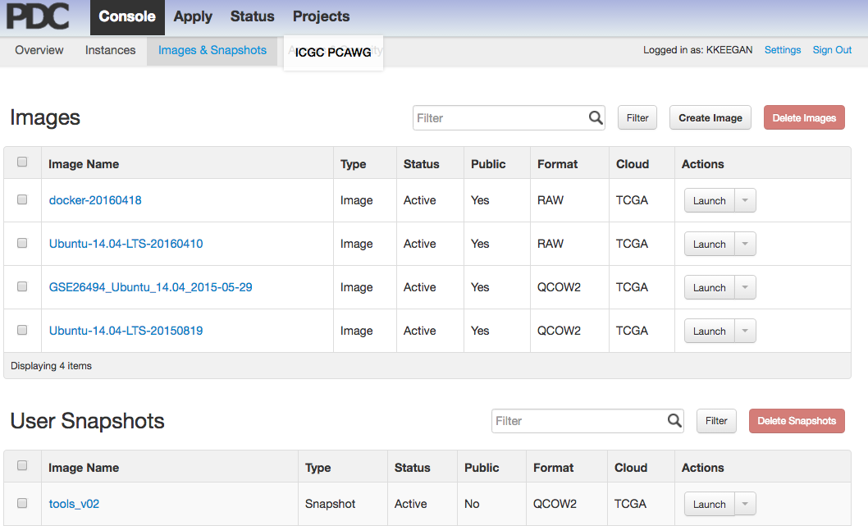
Your “images & snapshots” may not have the same list, of images and
snapshots, but the base images should be there, e.g. Ubuntu 14.04 LTS
(4) Determine the image that you want to create your VM from and press launch

Slide 50
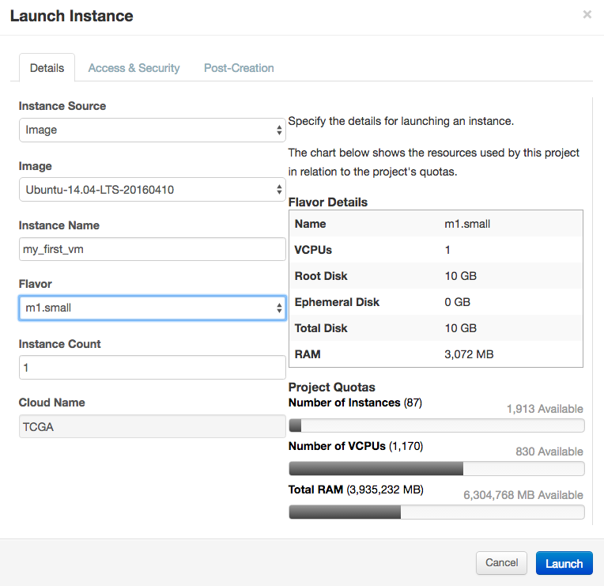
(7) Click on the “access & security” tab
(5) Create a name for your VM
(6) Select a vm flavor (m1.small):
Flavor determines
Number of CPUs
Root Disk
Ephemeral Disk
Total Disk
RAM
(a table of flavors appears on next page)

Slide 51
Step (6) addendum
Common VM flavors available on Bionimbus/PDC
ID | Name | Memory_MB | DiskGB | EphemeralGB | VCPUs
6 | m1.small | 3072 | 10 | 0 | 1
7 | m1.medium | 6144 | 10 | 0 | 2
8 | m1.large | 12288 | 10 | 0 | 4
9 | m1.xlarge | 24576 | 10 | 0 | 8
10 | m1.xxlarge | 49152 | 10 | 0 | 16
11 | m1.xxxlarge | 98304 | 10 | 0 | 32
12 | hs1.medium | 6144 | 20 | 0 | 2
13 | hs1.large | 12288 | 20 | 0 | 4
14 | gm.large | 24576 | 30 | 0 | 8
16 | hs3.xlarge | 24576 | 40 | 0 | 8
17 | gm.xlarge | 32768 | 40 | 0 | 8
18 | es1.small | 3072 | 10 | 1024 | 1
27 | es1.xxxlarge | 122880 | 40 | 1024 | 32
28 | es1.xxlarge | 61440 | 40 | 1024 | 16
29 | es1.xlarge | 30720 | 10 | 1024 | 8
30 | es1.large | 15360 | 10 | 1024 | 4
31 | hs3.large | 12288 | 40 | 0 | 4
32 | hs3.xxlarge | 49152 | 40 | 0 | 16
33 | br1.large | 15360 | 1000 | 0 | 4
34 | es4.xxxlarge | 98304 | 10 | 4096 | 32
Note: The flavor and number of VMs you are able to run will depend
on the limits of your tenant.

Slide 52
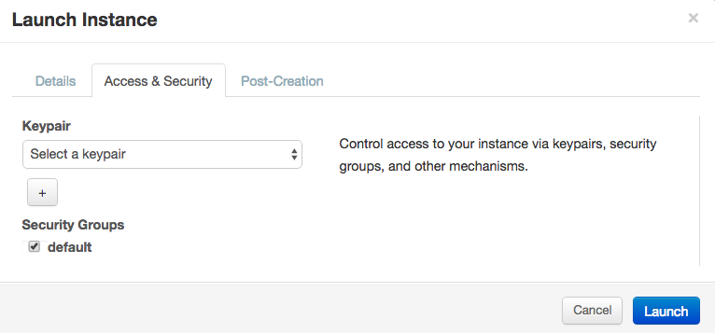
(8) Select the keypair to be used with the cluster
(9) Click on “Launch”
Note: Remember the key that you select – you’ll need it in a few steps

Slide 53
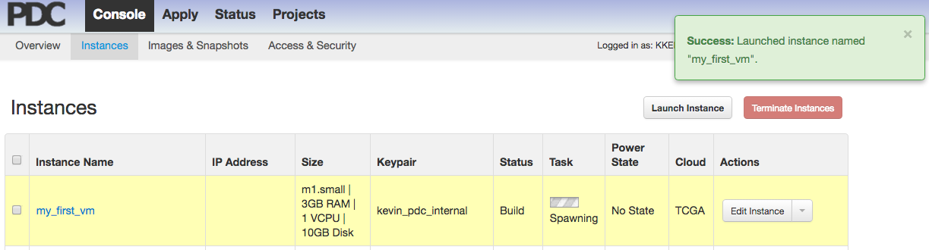
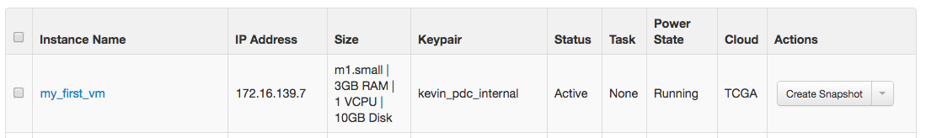
(10) You will automatically be taken to the “Instances” tab
You will see that your VM is in the process of being spun up
(11) When your VM is ready, an ip address will appear here
Copy your ip address, you will use it and the key name from the previous
step to edit your config file

Slide 54


Access the Bionimbus/PDC headnode from your Ubuntu virtual machine
Open the config file with emacs (or your favorite editor) “﻿emacs ~/.ssh/config”
Copy the following below your entry for the Bionimbus/PDC headnode,
edit the indicated portions:
Host any_name_you_want
Hostname VM_ip_address
IdentityFile /home/ubuntu/your_vm_key.pem
ProxyCommand ssh -q -A PDC -W %h:%p
Your config file should now look something like this -
To save the file, press
ctrl + x
and then
ctrl + s
To quit press
ctrl + x
and then
ctrl + c

Slide 55
Now you can log into your VM with a simple command like this
Type “yes” and press enter
You are now logged into your VM,
The config entry logs your into the headnode automatically
and then into your VM
This becomes extremely useful when you have to move files around.
scp some_file.txt my_vm:~/
Will transfer the file some_file.txt from your local machine to the VM
(you do not have to transfer it to the headnode as an intermediate step)

Slide 56


Section 2: Local configuration and Bionimbus/PDC basics
To use Bionimbus/PDC you need to learn 6 essential skills
How to use a linux/unix based operating system to interact with the system
How to create ssh keys for use on the headnode and your VMs
How to create a configuration file to log into the headnode and/or VMs easily
How to spin up VMs
How to obtain your objectstore credentials from the headnode
How to use your objectstore credentials to access the objectstore
(1) Log into the Bionimbus/PDC headnode from your ubuntu VM
(Like this if you followed the instructions for creating your config file earlier)
(2) Look for a file called “s3cred.txt”; you can just use “ls s3cred.txt” – it will return the
filename if it is there, and an error if it is not

Slide 57
Section 2: Local configuration and Bionimbus/PDC basics
If you do not see the s3cred.txt file, immediately send an email to
support:
support@bionimbus.org
If your are working closely with a Bionimbus/PDC / OSDC / or CDIS member you
should cc them on the email.
If you do see the file, please keep a few things in mind before proceeding
Your objectstore credentials are for you alone.
Bionimbus/PDC has a zero tolerance policy for sharing of keys.
If your keys are shared, access to the objectstore will be immediately terminated.
Each Bionimbus/PDC user in your group must have their own account and credentials for
accessing the objectstore. Anyone with your keys has the same level of access
to your data (to upload, download, or modify it) as you
That said – take a look at the contents of the “s3cred.txt file”
You can type “less s3cred.txt”. The contents will look something like this:
[[tenant_name]]
access_key=SOMESTRINGOFCHARACTERS #<- this is your access key
secret_key=ANOTHERSTRINGOFCHARACTERS #<- this is your secret key

Slide 58
Section 2: Local configuration and Bionimbus/PDC basics
To use Bionimbus/PDC you need to learn 6 essential skills
How to use a linux/unix based operating system to interact with the system
How to create ssh keys for use on the headnode and your VMs
How to create a configuration file to log into the headnode and/or VMs easily
How to spin up VMs
How to obtain your objectstore credentials from the headnode
How to use your objectstore credentials to access the objectstore
### 1 ### install awe-cli (linux/unix OSX)
In your ubuntu virtual box type (type “Y” if prompted):
sudo apt-get install awscli
If you are on OSX, you can try this:
sudo easy_install awscli

Slide 59
Section 2: Local configuration and Bionimbus/PDC basics
### 2 ### configure awscli
# Type the following at your Ubuntu/OSX prompt:
aws configure --profile A_NAME_FOR_YOUR_PROFILE
# You will be queried to enter the access key from above
# you can cut/paste the values and press enter
AWS Access Key ID [****************]:
# Do the same for your secret key
AWS Secret Access Key [****************]:
# Use 'us-east-1' as the default region name
Default region name [us-east-1]: us-east-1
# Just press enter to select the default ('None') for the output format
# An example appears on the next slide

Slide 60

Section 2: Local configuration and Bionimbus/PDC basics
Example configuration for awscli
You can name the profile whatever you want, here I called it “my_profile”
The access and secret keys have to be the access and secret keys from
your s3cred.txt file
NOTES: Some users may have more than one set of credentials – you can create
a profile for each. OSX users may run into an ssl problem – the solution is after
the next slide.

Slide 61
Section 2: Local configuration and Bionimbus/PDC basics
Assuming that you entered a “real” set of keys, you can now use awscli to easily
access your tenant on the object store.
Below is a list of common commands:
# list buckets
aws s3 ls --endpoint-url https://bionimbus-objstore.opensciencedatacloud.org --profile your_profile_name
# list items in bucket
aws s3 ls s3://test_bucket/ --endpoint-url https://bionimbus-objstore.opensciencedatacloud.org --profile your_profile_name
# make a new bucket
aws s3 mb s3://test-bucket --endpoint-url https://bionimbus-objstore.opensciencedatacloud.org --profile your_profile_name
make_bucket: s3://test-bucket/
# copy a local file to the bucket
aws s3 cp test_file s3://test-bucket/test_file --endpoint-url https://bionimbus-objstore.opensciencedatacloud.org --profile your_profile_name
# copy file from bucket to local
aws s3 cp s3://test-bucket/testobject.txt testobject.txt --endpoint-url http://bionimbus-objstore.opensciencedatacloud.org \
--profile your_profile_name
# sync a local directory to a bucket
aws s3 sync /path/to/local/dir/ s3://bucket_name/optional_path --endpoint-url https://bionimbus-objstore.opensciencedatacloud.org \
--profile your_profile_name
You can find additional/further documentation from several sources starting with:
https://www.opensciencedatacloud.org/support/pdc.html
https://aws.amazon.com/cli/

Slide 62
Section 2: Local configuration and Bionimbus/PDC basics
If you use OSX to access the object store, and receive an error like the following:
EOF occurred in violation of protocol (_ssl.c:590)
You have an outdated ssl. The easiest solution is to use the ubuntu VM.
Otherwise, you can create a virtual environment on your OSX machine like this:
mkdir -p ~/.virtualenvs
export WORKON_HOME=~/.virtualenvs
mkvirtualenv --python=~/.virtualenvs/versions/2.7.10/bin/python 2.7.10
pip install awscli
# Create a profile (see previous slides)
# Use the virtual environment when you need to access the objectstore
# start virtual environment
workon 2.7.10
# Do your work with the objectstore
# exit virtual environment
deactivate

Slide 64

Appendix
Obtaining an account
Go to this address:
https://bionimbus-pdc.opensciencedatacloud.org/
Click on this button

Slide 65

Appendix
Obtaining an account
Log in with your eRA commons account
or
Follow instructions in the FAQ for creating an account

Slide 66
Appendix
Once you have an account got to:
https://bionimbus-pdc.opensciencedatacloud.org/console/
Enter your username
your password
and click on “log in”
Click here

Slide 67
Appendix
This is the console,
The numbers on yours will be different; the will reflect what is available on your tenant

